Slide 1
Thermal-lens technique - an introduction
Dr. Rajesh Kumar B
Assistant Professor
Department of Physics
Nirmala College
Muvattupuzha
Kerala

Slide 2
Principle of Thermal-lens Technique
Absorption of radiation results in the excitation of atoms or molecules
Two pathways for de-excitations
Radiative de-excitation
Nonradiative de-excitation
The nonradiative way of de-excitation results in the
generation of heat in the sample

Slide 3
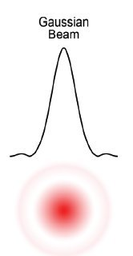
Thermal-Lens Technique
In the thermal-lens (TL) technique the sample is illuminated by a Gaussian laser beam
The heat generated is strongest at the center of the beam because the beam intensity is strongest at that point. Consequently, a thermal gradient results between the center of the beam and the bulk material
The thermal gradient in turn establishes a refractive index gradient. Owing to the gradient in the refractive index, the medium acts as a lens like optical element, called thermal lens
When a probe beam passes through the TL, it get diverged or focused depending upon the coefficient of refractive index with temperature
For most liquids, the temperature coefficient of refractive index, dn/dT is negative leading to thermal blooming
Gaussian Laser Beam
Probe beam
Sample

Slide 4
Dual Beam Thermal-lens Setup

Slide 5
Advantages of Thermal-lens Technique
High sensitivity
Accuracy
Minimum sample requirement
Non-destructive
Non-contact nature

Slide 6
Thank You

