Slide 1

An introduction to Nanoscience & technology
Dr. Thomas Varghese
Associate Professor
Dept. of Physics
Nirmala College, Muvattupuzha
www.nsrc.in
Email:nanoncm@gmail.com

Slide 2
Definition
The Greek word nano means dwarf-extremely small
A nanometer (nm) equals 10⁻⁹ meter
One human hair is about 80,000 nm thick
An atom is about 0.1 nm wide
A DNA molecule is about 2.5 nm wide
A red blood cell is about 5,000 nm in diameter
A nanoelement can be compared to a basketball, like a basketball to the size of the earth.

Slide 3
Definition…
The art and science of manipulating and rearranging atoms and molecules to create useful materials, devices, and systems
At nanoscale regime, materials exhibit unique properties
The properties of the materials are all size and shape dependent

Slide 4
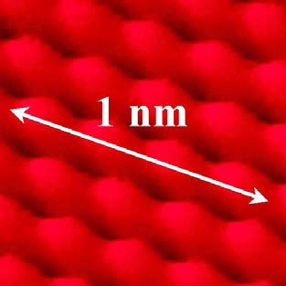
Nanometer ?
One nanometer is the space occupied by 3-4 atoms
placed end-to-end

Slide 5
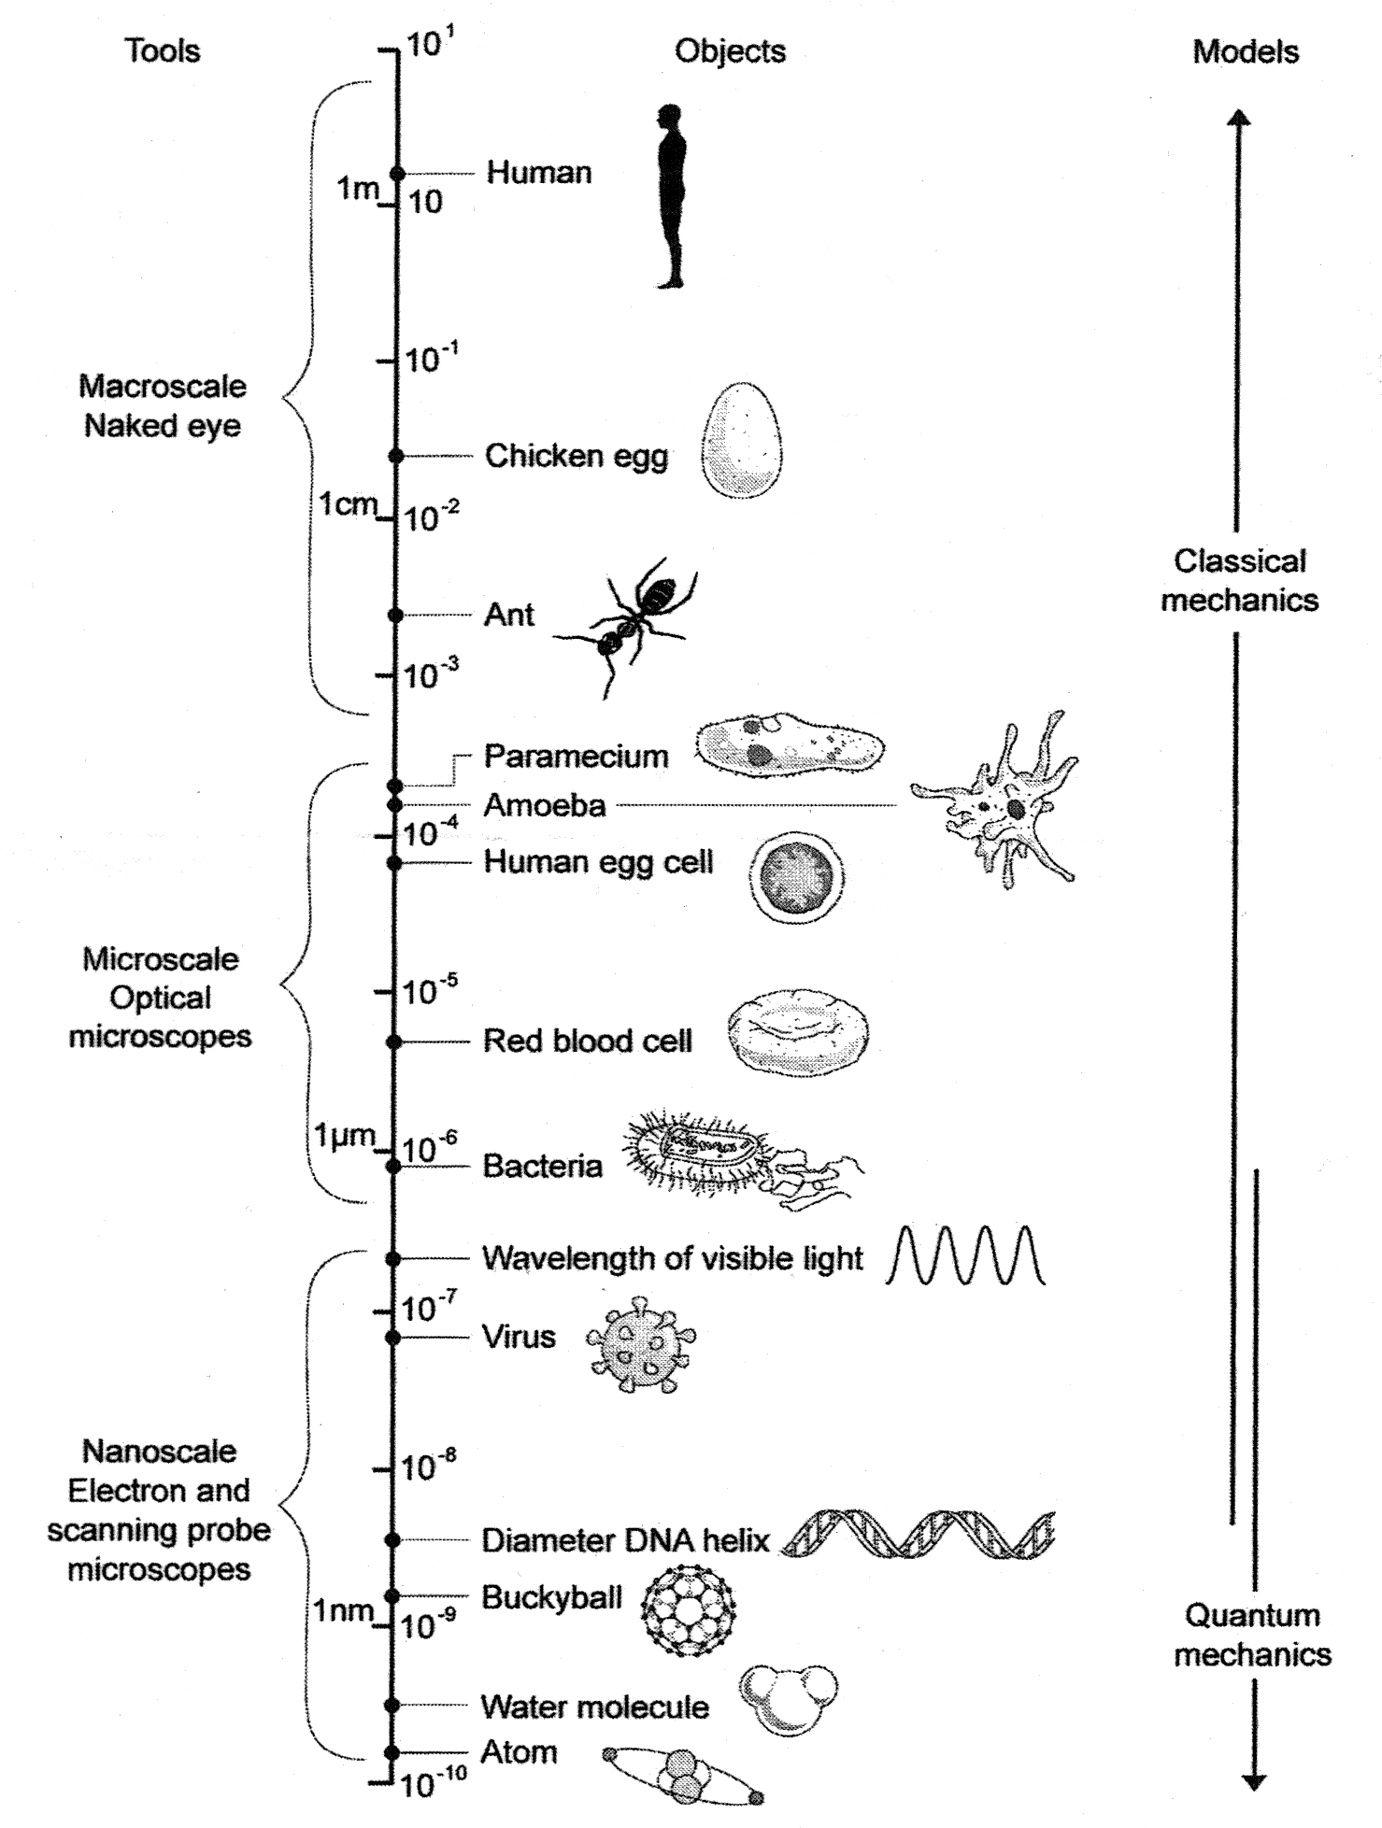

Slide 6
History
Ancient people employed nanotechnology
IVcentury, Roman glass workers were fabricating glasses containing nanometals
Colour of glass windows of medieval churches are due to metal nanoparticles (silver and gold).
The strength and sharpness of Damascus sword (17th Century) was due to the presence nanowires and nanotubes in the sample

Slide 7
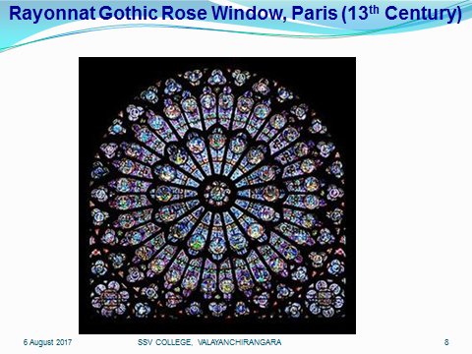

Slide 8
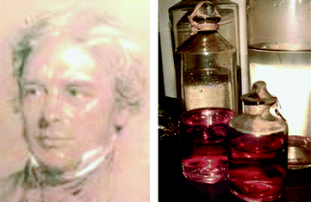
Faraday prepared gold nanoparticles (1857)
Preserved in the Royal Institution, London

Slide 9
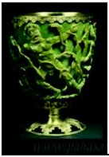
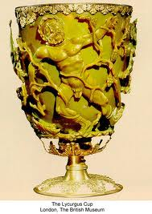
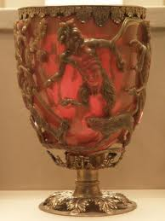
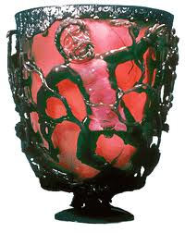
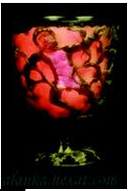
Lycurgus cup (IV Century)
Lycurgus cup: British Museum, London
It is made from soda lime glass containing nanoparticles of silver and gold. Its colour changes from green to red when a source of light is placed inside the cup. The Cup shows the myth of King Lycurgus

Slide 10
History…
The concept of atomic precision was first suggested by Physics Nobel Laureate Richard P. Feynman (1959) in his speech entitled, “There’s Plenty of Room at the Bottom” on the occasion of the annual meeting of the American Physical Society

Slide 11
Feynman’s Speculations…
“A biological system can be exceedingly small. Many of the cells are very tiny, but they are very active; they manufacture various substances; they walk around; they wiggle; and they do all kinds of marvelous things – all on a very small scale. Also, they store information. Consider the possibility that we too can make a thing very small which does what we want – that we can manufacture an object that maneuvers at that level.”
Richard P. Feynman, 1959

Slide 12

Feynman’s Speculations…
There is enough room on the head of a pin to put all of the Encyclopedia Britanica
A library with all the world’s books would fit in a pamphlet in our hand
But, his speculations did not understand by scientists at the time
His fictions have become reality today

Slide 13
History…
In1974, Nario Taniguchi used the term “Nanotechnology” to describe materials with scales less than a micrometer
Eric Drexler has given widespread propaganda in popularizing nanotechnology.
“Engines of Creation” (Drexler ,1986), introduced a world of tiny machines or assemblers that can construct new structures with atomic level precision.
Richard E. Smalley (1985) and his co-workers discovered buckminsterfullerence /fullerene (buckyballs), soccer ball shaped molecules made up of carbon.
Sumio Iijima (1991), discovered carbon nanotubes

Slide 14

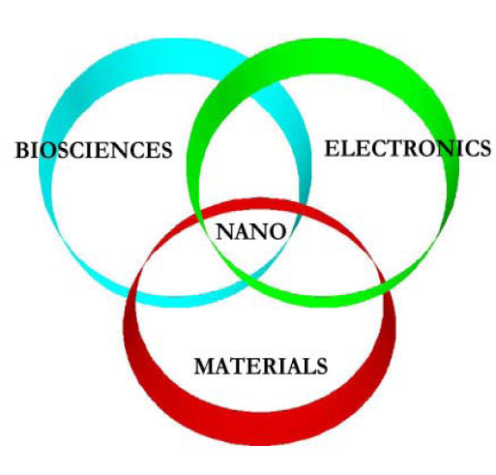

Slide 15
Important functions of living organisms at nanoscale!!!
5 nm wide heamoglobin carries oxygen through the bloodstream
A few nm sized neuro cells can store lot of information
DNA molecule (2.5 nm) stores Genetic information
Photosynthesis is enabled by nanoscale molecules like chlorophyll pigment inside the chloroplast cells
Self cleaning nature of lotus leaf comes from nanospikes present on its surface
Water striders walk on the surface of water without getting wet because of the nano-grooves present in the microhairs of their legs.

Slide 16
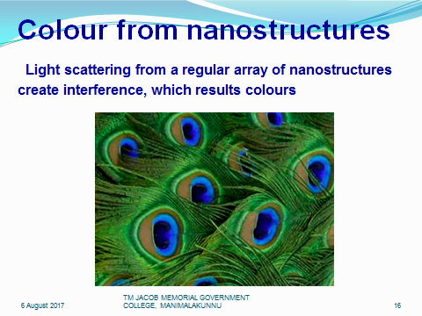

Slide 17
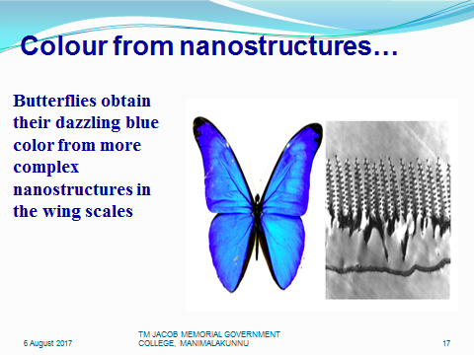

Slide 18
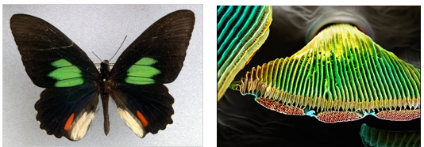
Colour from nanostructures…

Slide 19
Nature: The best Nanotechnologist!!!
Researchers hope to imitate nature’s secrets of building from nanoscale
Nanoproducts
Water repellent cloths are manufactured by copying the secret of nanostructure of lotus leaves
Bandage coated with Ag nanocrystals to prevent infection – Anti bacterial property
Nanocosmetics to keep the skin to remain soft & wrinkle free
Self cleaning window glass covered with a layer of TiO2 nanoparticles. The dirt on the surface is loosened as the nanoparticles interact with UV rays from sunlight, and is washed off when it rains.

Slide 20
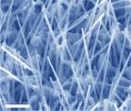
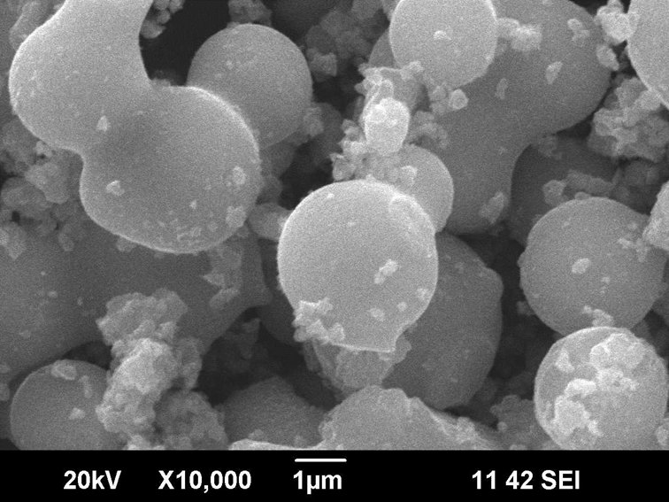
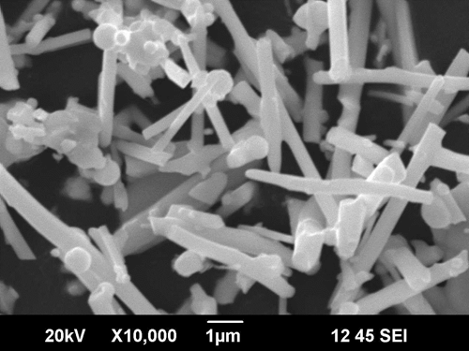
Morphology of nanostructures…

Slide 21
Dimensional Classification of nanostructure
Dimensions | Criteria | Examples
Zero Dimensional (0-D) | All dimensions in the nanometer range | Nanoparticles, quantum dots, nanodots
One Dimensional (1-D) | One dimension of the nanostructure is outside the nanometer range | Nanowires, nanorods, nanotubes
Two Dimensional (2-D) | Two dimensions are outside the nanometer range | Coatings, thin-film-multilayers
Three Dimensional (3-D) | Three dimensions are outside the nanometer range | Bulk

Slide 22
Quantum Dots
Quantum dots: Semiconductor nanoparticles - (CdSe or ZnS), Size range from 2 to 10 nm [Size of the particles comparable to the de Broglie wavelength of the carriers (electrons and holes)]
Quantum dots shows unique optical and electrical properties
The most important is the emission of visible light (photons) under excitation
The wavelength of these photon emissions does not depends on the material, but the size of quantum dot

Slide 23
Quantum Dots…
Quantum dots can be “tuned” by changing the size during production to emit any colour of light
The ability to tune the emission from the quantum dot by changing its size is called the “Size quantisation effect”.
Quantum dots can even be tuned beyond visible light, into the infra-red or into the ultra-violet

Slide 24
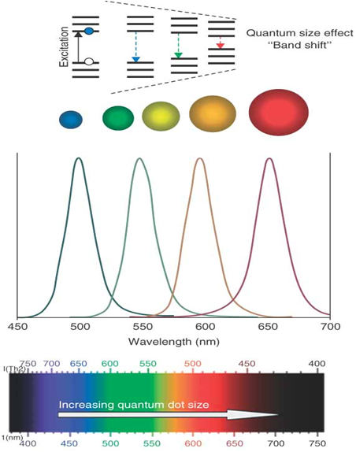

Slide 25
Quantum effect
Tunability of materials properties
Nanoscale gold particles selectively accumulate in tumors
Precise imaging and targeted laser destruction of the tumor

Slide 26
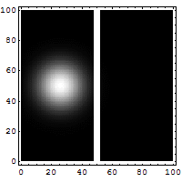
Tunneling of particles through barrier
Scanning tunneling microscope and flash memory for computing

Slide 27
Quantum Wires
Quantum wire is an electrically conducting wire in which quantum effects influence the transport properties
If the diameter of a wire is at the nanoscale, electrons will experience quantum confinement in the transverse direction. Hence, their transverse energy will be quantized into a series of discrete values
The classical formula for calculating the electrical resistance of a wire: R = ρl/A, is not valid for quantum wires (where ρ is the resistivity, l is the length, and A is the cross-sectional area of the wire)

Slide 28
Quantum Well
A quantum well is a thin layer in which particles are confined in the dimension perpendicular to the layer surface, like a potential well with only discrete energy values
The effects of quantum confinement take place when the quantum well thickness becomes comparable to the de Broglie wavelength of the carriers (electrons and holes), i.e., the carriers can only have discrete energy values.
Quantum wells are formed in semiconductors by having a material, like gallium arsenide sandwiched between two layers of a material with a wider band gap, like Aluminium arsenide.

Slide 29
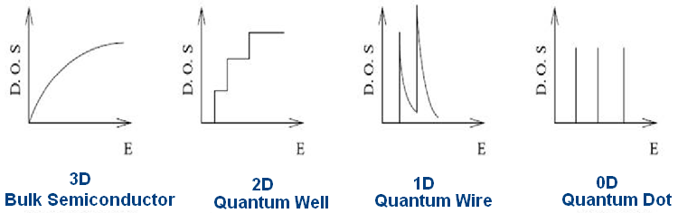
Energy states
Bulk

Slide 30
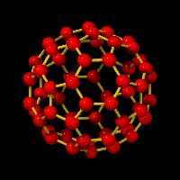
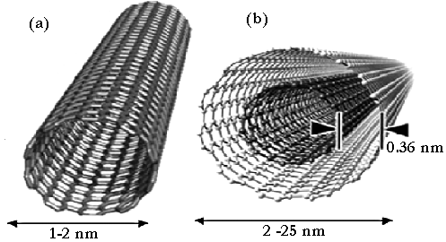
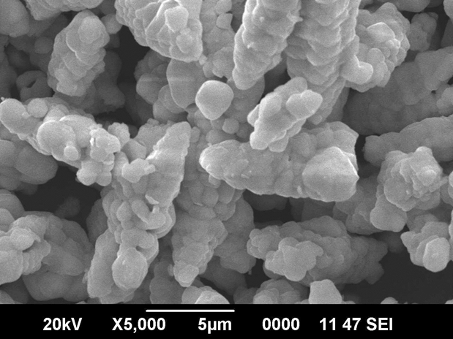
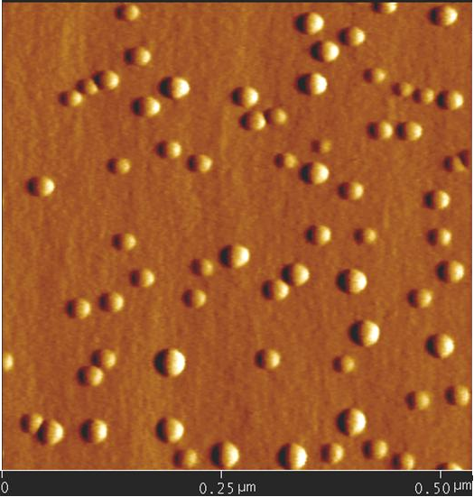
Examples of Nanomaterials
Fullerenes C₆₀ and C₅₄₀.
CNTs
BaWO4 nanostructures
Quantum dots

Slide 31
Materials exhibit peculiar properties at nanoscale!!!!!
Nanoscale Al can combust spontaneously and can be used in rocket fuel
Nanoscale Cu is highly elastic & can be stretched up to 50 times its length
CNT shows tensile strength 100 times than that of steel, but graphite is soft
Nanoscale ZnO is transparent but at large scale it becomes white and opaque

Slide 32
Size dependent properties
Nanoscale is a magical point on the dimensional scale
The quantum effects rule the behavior and properties of particles
Nanoscale components have very high surface area to volume ratio, so surface effects are far more significant
Stickiness at the Nanoscale: Electromagnetic forces bind everything, hence the stickiness

Slide 33
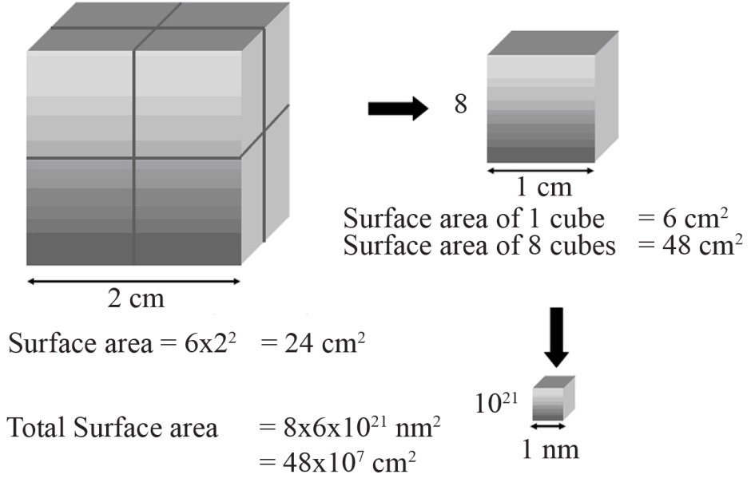
Is surface area Increased?

Slide 34
Size dependent properties…
Gravitational forces are negligible due to small mass of the particles, while electromagnetic forces are very strong in nanosized particles and are dominant in determining the bahaviour of particles.
The other two forces, the strong nuclear force and weak nuclear force, are only significant at extremely short distances and hence become negligible in the nanoscale.
At nanoscale, the influence of random molecular motion( KE) is important. At the macroscale this motion is very small compared to the sizes of the objects and thus is not influential in material behaviour. However at the nanoscale, these motions can be on the same scale as the size of the particles and thus have an important role on material behaviour.

Slide 35
Size dependent properties…
The nanoscale sized objects exhibit peculiar properties because of
The dominance of electromagnetic force
The presence of quantum mechanical phenomena,
The large surface area to volume ratio and
The importance of random motion

Slide 36
Size dependent properties…
Example
Gold nanoparticles shows different colours at nanoscale. And if we change the size, their color changes. Since, each of the different sized nanoparticles absorbs and reflects light differently based on its energy levels, which are determined by size and bonding arrangements.
The individual atoms do not have colour. The colour of a substance is determined by the wavelength of the light that reflects it and one atom is too small to reflect light on its own.

Slide 37
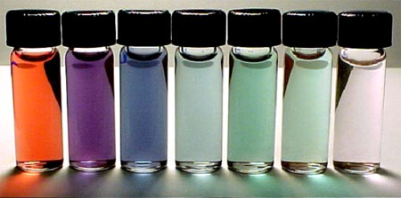
Colour change of Au Nanoparticles with size

Slide 38
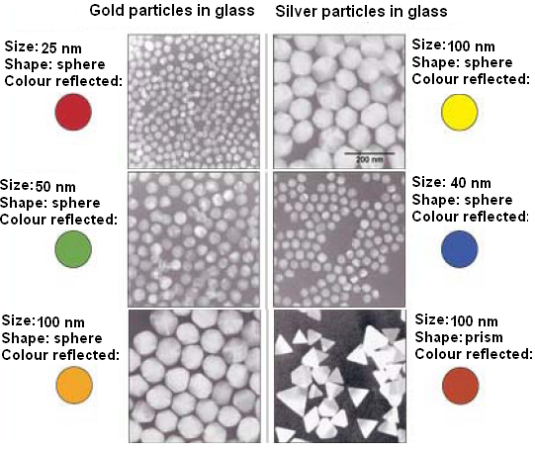
Glass containing gold and silver nanoparticles

Slide 39
Properties of Nanomaterials
1. Chemical reactivity
High reactivity due to large surface area to volume ratio.
For example, the reactivity of a metal catalyst particle increases appreciably as its size decreases- macroscopic gold is chemically inert, whereas at nanoscale, gold becomes extremely reactive and catalytic.

Slide 40
2. Melting Points
Nanoparticles of metals, semiconductors, nanowires, inert gases and molecular crystals are all found to have lower melting temperatures, when their particle size decreases below 100 nm. Reason is that the surface energy increases with decreasing size.

Slide 41
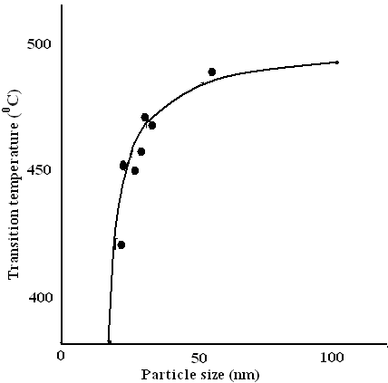
The transition temperature as a function of particle size.

Slide 42
3.Quantum Size Effects
When the size of a nanocrystal is smaller than the de Broglie wavelength, electrons and holes are spatially confined , lose their freedom in 3D and electric dipoles are formed, and discrete electronic energy level would be formed in all materials. Similar to a particle in a box, the energy separation between adjacent levels increases with decreasing dimensions
If size of the element L_{c} ≈ λ = h/p, nanoparticles (also called quantum dots) behave like large atoms, and electronic energy levels are discrete as in an atom.
Whenever the size of the object is equal to electron wavelength or even smaller, quantum effects govern the wave propagation of the system. This effect is called the Quantum Size Effect (QSE).

Slide 43
Energy Level Diagram: Quantum Size Effects
BULK
SEMICONDUCTOR
NANOPARTICLE
CB
E_{g}
E_{g}
E_{g}
VB

Slide 44
Variation of Band gap with particle size

Slide 45
4. Electrical conductivity
When the material’s dimension < mean free path of electron, the electron motion will be interrupted through collision with the surface, the electrical conductivity decreaes.
Change of electronic structure: When size is reduced below a critical size (de Broglie wave length), the band gap of the material will be widened, and hence, a low electrical conductivity. Some materials become semiconductors and semiconductors become insulators
Eg., Bi nanowires at 52 nm become semiconducting & Si nanowires at 15 nm become insulating

Slide 46
5. Superparamagnetism
When the size of the ferromagnetic particles < 15 nm, they possesses a large magnetic susceptibility in an external field, but has no residual magnetism. This phenomenon is known as superparamagnetism.
The ferromagnetic substances become unstable when the particle size reduces below the limit because the surface energy provides a sufficient energy for domains to spontaneously change polarization directions.
Hence, ferromagnetics become paramagnetics and behaves differently from conventional paramagnetic. Thus, there is a lower limit to the size of the magnetic elements in nanostructured magnetic materials for data storage, typically about 20 nm. Below this limit, zero hysteresis and consequently incapable to store magetization oriented information.

Slide 47
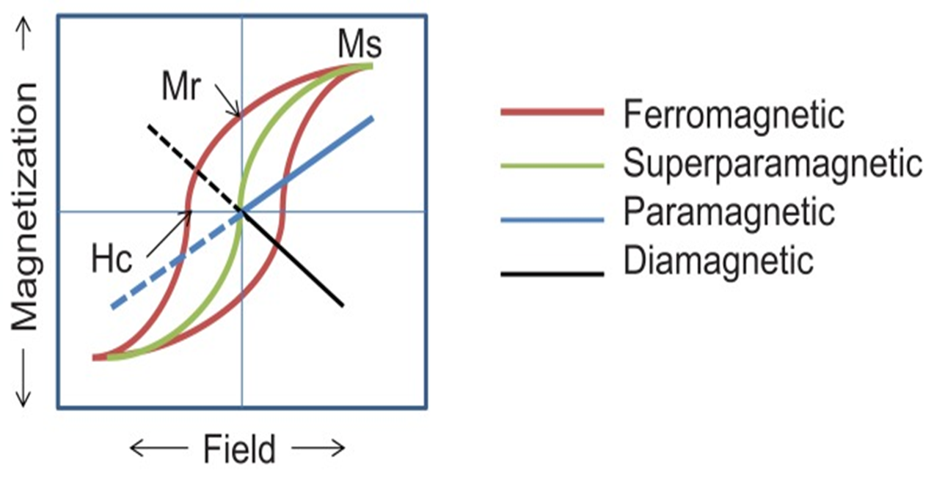
Magnetization curve

Slide 48
6. Thermodynamic properties
Thermodynamic properties depend on surface area to volume ratio and Surface energy, which is high for nanomaterials.
Specific heat, entropy, and thermal expansion of nanoparticles are much different (large) from their bulk form. But, melting points lowers.

Slide 49
7. Mechanical properties
The mechanical properties depend on the density of dislocations, interface-to-volume ratio and grain size.
At nanoscale, the hardness, elastic modulus, scratch resistance and fatigue strength etc are very high. Because, nanomaterials have less imperfections (dislocations, micro-twins, impurity precipitates) and perfect side faces.
Many of the nanomaterials shows super hardness & superplastcity.
The Young’s modulus of nanotube is 1-2 TPa, about 5 times higher than steel. Its tensile strength is around 150 GPa, about 50 times higher than steel.
Nanocomposites made from CNTs and polymers shows amazing mechanical properties like Y, stiffness &flexibility

Slide 50
8.Optical properties
Optical absorption
PL emission
It is possible to tune optical absorption/PL emission of materials by changing their size, electron beam irradiation, doping with suitable dopants etc.
Eg. TiO2

Slide 51
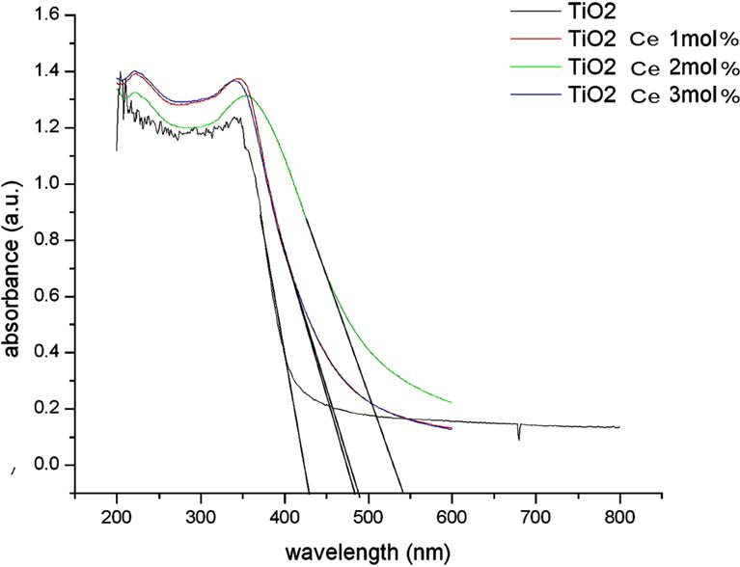

Slide 52
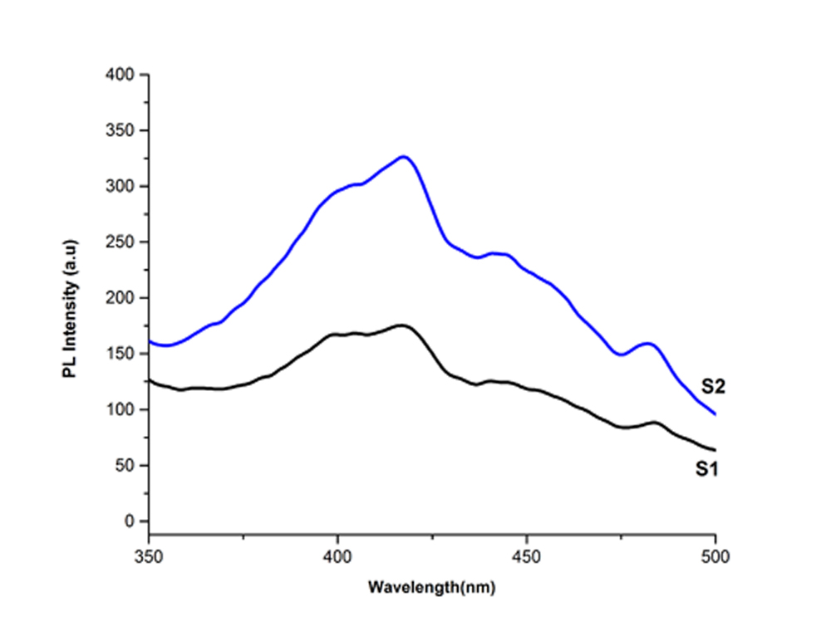
PL Emission spectra of Alpha-Ag2WO4

Slide 53
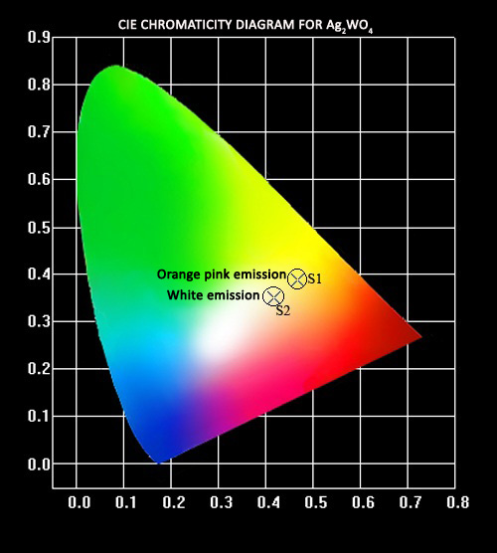

Slide 54
8.Optical Properties…
When metal absorbs light of resonant wavelength, the coherent excitation of entire free electrons in the CB occurs, it results an in-phase oscillation, called surface plasmon resonance (SPR). It occurs at the surface, hence, the name surface plasmon resonance.
Nanoparticles exhibit SPR in the visible part of EM spectrum. Certain wavelength of visible light will be absorbed and are converted into surface plasmons. However, remaining part will be reflected and give rise to a certain colour for the material. Colour changes with size & shape.

Slide 55
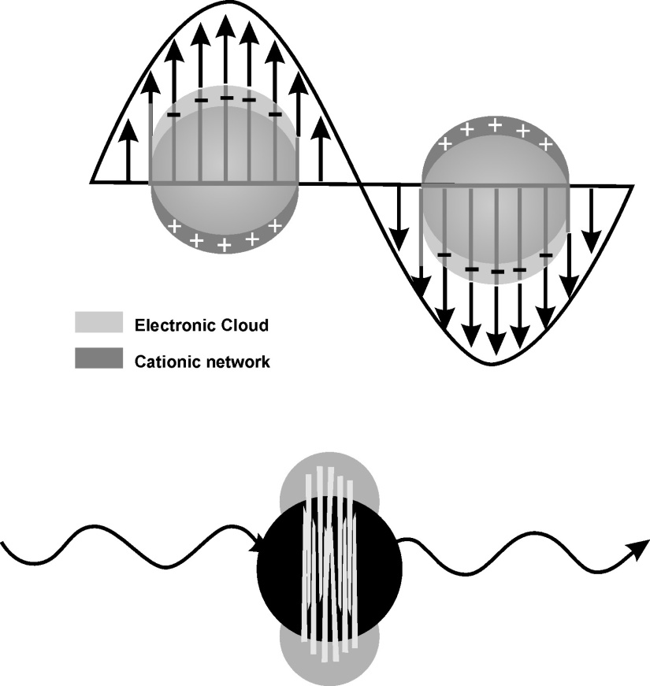
Surface Plasmon resonance

Slide 56
9. Viscosity at the nanoscale
0
Water, at the nanoscale, is not the free flowing liquid we are used to in the macroscale. Tiny objects in water are surrounded by a sticky viscous fluid.
The Viscocity of fluids is dominated at the nanoscale.
Force of viscosity is; F= ηav, where η is the liquid viscosity.
Reynolds number = ρav/ η
For a smaller surface area (a), the Reynolds number is smaller and hence the effect of viscosity gets greater and will effect the motion of the small object more.
A bacterium is a million times smaller than a human, so the bacterium feels water one million times more viscous than we do!

Slide 57
Synthesis Approaches
Top-down – Breaking down matter into more basic building blocks. Frequently uses chemical or thermal methods. Egs. Ball milling
The imperfection of the surface structure is the main draw back. The imperfection affects both physical & chemical properties of nanomaterials, since their surface-to-volume ratio is very high
Bottoms-up – Building complex systems by combining simple atomic-level components.
Physical and chemical forces working at nanoscale enable the basic units to assemble into larger structures
It provides nanostructures with less defects and imperfections
Egs. Epitaxial growth, Sol-gel technology, laser ablation, physical and chemical vapour deposition

Slide 58
Characterization tools
X-ray diffraction (XRD)
SEM
TEM
FTIR
UV-Visible absorption spectroscopy
PL spectroscopy
Raman spectroscopy
Impedance analysis
Vibrating sample magnetometer (VSM)

Slide 59
Clusters & Magic Numbers
Atoms join together to form clusters
Clusters with certain number of atoms in the group are more stable than others.
Magic number is the number of atoms in the clusters with higher stability For eg. 1. Clusters of Krypton atoms are stable when number of atoms N=13,55, 147, 309, 561….., C60 –Fullerene
It has been seen that for some specific numbers of atoms (N) in the cluster, N= 2,8, 20, 40, 58, 92 etc , the free energy is lower, resulting stabilization of the cluster.

Slide 60
Applications
1. Nanoelectronics & Molecular electronics
Wide applications in every sector of electronics field, which includes field emitters and flat panel displays, molecular switches, nanotube transistors and field effect transistors, nanotube ICs, biomedical electronic devices and nano-biosensors
The semiconducting properties of C₆₀, C₇₀ or C₈₄ can be used for the construct of Organic Field Effect Transistors (OFETS)
Molecular Electronics using molecules in the fabrication of electronic components. , therby reducing the size of electronic devices & extend Moore’s law beyond the limits of conventional silicon technology. When electronic devices approach the nano ,the bulk properties of solids are replaced by the quantum mechanical properties such as energy quantization and tunneling.

Slide 61
Nanowire-based vertical surround Gate FET

Slide 62
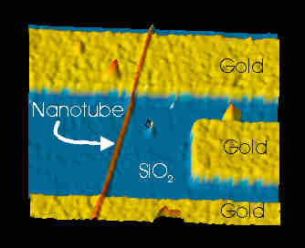
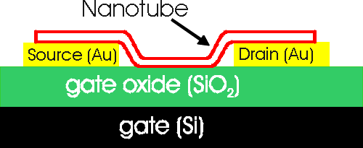
CNTs based FET

Slide 63
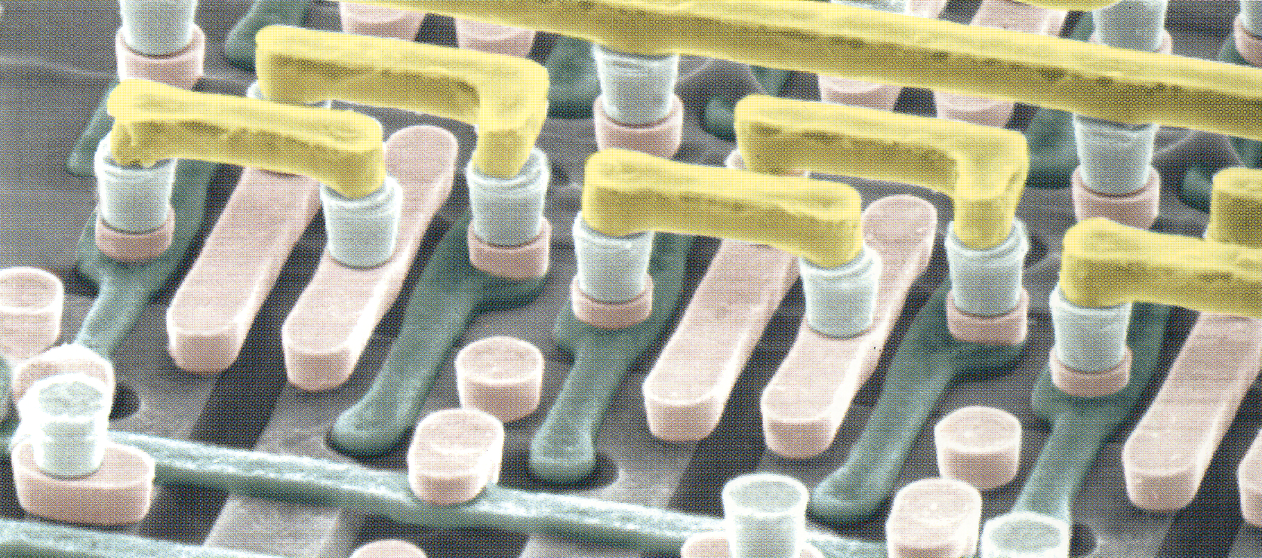
MWNT Interconnects

Slide 64



Solar cells: Solar windows/bags

Slide 65
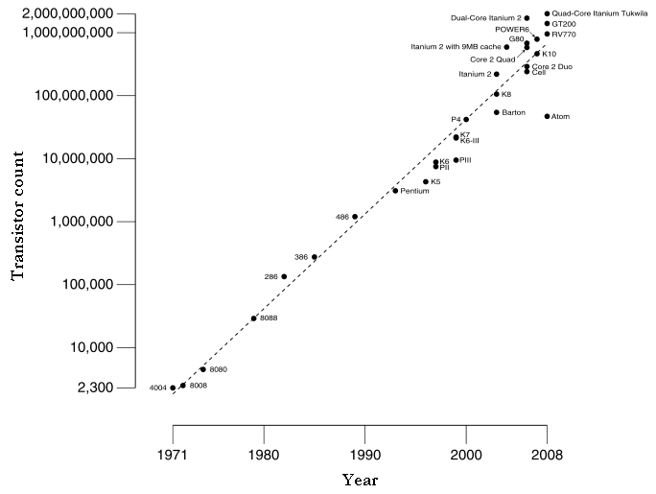
Moore’s Law (1965): Number of transistors on an IC chip of given area would double in every two years.
Moore’s law plot

Slide 66
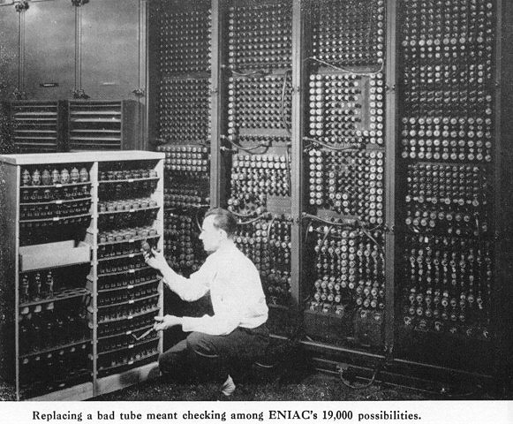

Slide 67
ENIAC
Cost: 5 million dollars ~ 2 crores rupees
Vacuum tubes:17,468
Crystal diodes: 7,200
Relays: 1,500
Resistors:70,000
Capacitors: 10,000
5 million hand- soldered joints!!!
Area1800 square feet
Power: 150 kW
When ever the computer was switched on, lights in Philadelphia dimmed !!!

Slide 68
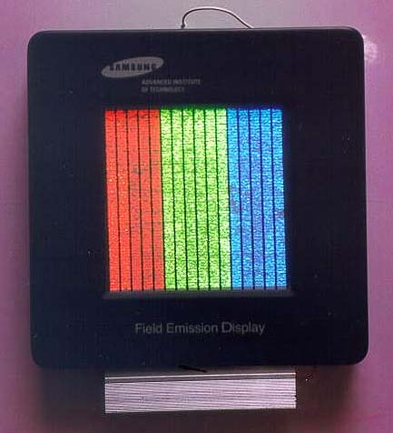
Field Emission and Flat Panel Displays
When a small electric field is applied along the nanotube axis, the ends of CNT emit electrons with a large emission rate like water being pushed through a high powered hose. This effect is called field emission.
This property helps to replace conventional electron gun with CNT electron gun; CNT based flat panel display.

Slide 69
Applications…
2. Medical
Size and shape dependent optical properties, large surface area-to-volume ratio, high surface energy and tunable surface properties make them suitable for biomedical applications
Nanomaterials based biosensors for the diagnosis of diseases, drug delivery, cellular imaging and so on.
Metal nanoparticles, oxide nanoparticles, quantum dots, nanowires, nanoshells, carbon nanotubes (CNTs), and composite nanoparticles are useful in biosensors for the diagnosis, tratment and monitoring of diseases.
Nanoparticles are easily absorbed by the cells due to their small size
and are fully soluble, hence, may not cause tissue damages.

Slide 70
Drug delivery
Deliver sufficient dosage of drug to the infected part of the body, minimum side effects.
Nanotube, nanoshell etc have hollow and porous structures, ideal for drug delivery vehicles.
SWNTs show optical absorbance in the near infrared (NIR) range. The absorbance of NIR light can generate heat that triggers the release of drugs from the nanotube surface.
Medicinal fluids containing nanorobots can perform delicate surgeries, repair cancer cells and mutations in DNA, destroy toxic chemicals and attack viruses to make them harmless.

Slide 71
Nanorobot…
Cancer primarily occurs due to mutation and hence, there is a change in the genetic information stored in the DNA
The affected cells divide repeatedly and cause the formation of tumors.
Nanobots can enter into the infected cell and will repair the damaged DNA.
They can also make out abnormal growth of cells and thus, the early detection of cancer.

Slide 72

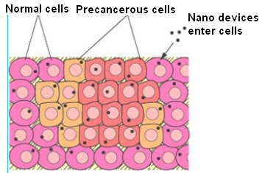

Slide 73
Radiotherapy
Radioactive smart bombs with Buckyballs – radioactive actinium 225 atom is placed inside, protein on the outside, protein attaches only to the cancer cell
Cures for AIDS, Cancers, Alzheimer's, Diabetes
Nanosensors for diagnosis (10 Xs faster) - Nanosensors can test immediately for hundreds and even thousands of viruses simultaneously

Slide 74
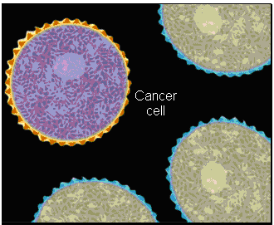
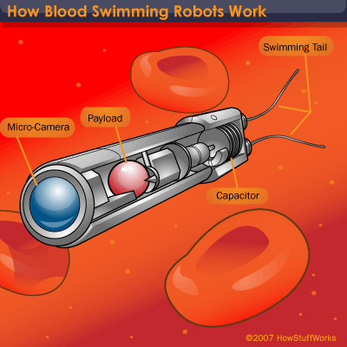
1. Molecular imaging of Cancer Cells 2. Multicolour imaging of cells using QDs
Blood swimming nanorobot

Slide 75
3. Food and Agriculture & Environmental Protection
Detection, sensing and eradication of contaminates from air, water and soil
New techniques for water filtration as well as desalination
Help to improve agricultural yields
Develop new functional materials and design new instruments for food preservation and bio-security
Modify the genetic constitution of the crop plants
Plant disease diagnosis & therapies
Yield optimization by nano-based precision farming; Nanosensors will control the release and storage of pesticides and nutrients.
Programmable airborne nanorobots can help to rebuild the thinning ozone layer in the atmosphere. They can also be used to remove excess co₂ in the atmosphere.

Slide 76
4. Energy
Energy storage, energy conversion, energy saving and effective utilization of renewable energy sources
Hydrogen is found abundant in nature and is an ideal fuel source. CNTs and graphite nanofibres (GNFs) are excellent for hydrogen storage. They are eco-friendly form of energy, byproduct is water. Nanomaterials (nanotubes), have a large number of nanopores and hence, they are suitable for hydrogen storage.
Lightweight and high energy density batteries are of great demand. Nanomaterials with aerogel structure are best suited for separator plates in batteries and needs less frequent charging.
Nanomaterials based light emitting diodes (LEDs) and quantum caged atoms (QCAs) can best suited for lighting.

Slide 77
Energy…
Energy Sources: Photovoltaic Cells, Nuclear Reactors (radiation shielding and protection), Wind Energy (Nano composites for lighter and stronger rotor blade)
The use of quantum dots for solar cells can enhance the efficiency of solar cells.
Energy Storage: Batteries (nanostructured electrodes and ceramic separator foils); Supercapacitors (Nanomaterials for electrodes such as CNT, metal oxides, and electrolytes for higher energy density); Hydrogen Storage; Fuel Tanks (nanocomposite based)

Slide 78
5.Self Powered Nanosystems
Nanodevices need a power source (nW - µW) to work continuously without increasing weight.
Energy harvested from the environment is enough.
Example: Human body provides mechanical energy, vibration energy, chemical energy (glucose), and hydraulic energy. If this energy is made as electrical energy, sufficient to provide power to nanodevices.
Techniques used: Photovoltaic, thermoelectrics, mechanical vibration and piezoelectric vibration etc.

Slide 79
New risks to human health/environment
Blood-brain barrier (BBB) effect
Nanomaterials can cross the BBB and will damage the barrier integrity, which may cause nerve cell damage and neuron death
Nanomaterials from nanoproducts pose environmental pollution, which may affect useful microorganisms, fish etc.

Slide 80
Conclusions
Nanotechnology has a significant impact on Science and Society and all Sectors of Economy
However, they may pose new risks to human health

Slide 81
Thank you
“Science is not belief, but the will to find out.”

